Slide 1


Chapter 4
Network Layer:
The Data Plane
A note on the use of these Powerpoint slides:
We’re making these slides freely available to all (faculty, students, readers). They’re in PowerPoint form so you see the animations; and can add, modify, and delete slides (including this one) and slide content to suit your needs. They obviously represent a lot of work on our part. In return for use, we only ask the following:
Computer Networking: A Top-Down Approach
8th edition
Jim Kurose, Keith Ross
Pearson, 2020
If you use these slides (e.g., in a class) that you mention their source (after all, we’d like people to use our book!)
If you post any slides on a www site, that you note that they are adapted from (or perhaps identical to) our slides, and note our copyright of this material.
Thanks and enjoy! JFK/KWR
All material copyright 1996-2016
J.F Kurose and K.W. Ross, All Rights Reserved

Slide 2
Chapter 4: network layer
chapter goals:
understand principles behind network layer services, focusing on data plane:
  network layer service models
  forwarding versus routing
  how a router works
  addressing
  generalized forwarding
instantiation, implementation in the Internet
  IP protocol
  NAT
Generalized Forwarding and SDN

Slide 3

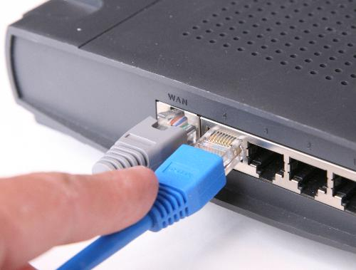
The Network Layer
Overview
Transport layer
Provides various forms of process-to-process communication by relying on the network layer’s host-to-host communication service.
Network layer
Decomposed the network layer into TWO parts: Data Plane (Chapter 4) & Control Plane (Chapter 5)
Can provide its host-to-host communication service.
the most complex layer in the protocol stack.
4-3

Slide 4
Chapter 4: data plane
4.1 Overview of Network layer
  data plane
  control plane
4.2 What’s inside a router
input ports, switching, output ports, buffer management, scheduling
4.3 IP: Internet Protocol
  datagram format
  fragmentation
  IPv4 addressing
  network address translation (NAT)
  IPv6
4.4 Generalized Forwarding and SDN
  Match+action
  OpenFlow: match+action in action

Slide 5
















Network layer services and protocols
transport segment from sending to receiving host
  sender: encapsulates segments into datagrams, passes to link layer
  receiver: delivers segments to transport layer protocol
network layer protocols in every Internet devices: hosts, routers
routers
  router examines header fields in all IP datagrams passing through it
  moves datagrams from input ports to output ports to transfer datagrams along end-end path
application
transport
network
data link
physical
network
data link
physical
network
data link
physical
network
data link
physical
network
data link
physical
network
data link
physical
network
data link
physical
network
data link
physical
network
data link
physical
network
data link
physical
application
transport
network
data link
physical
network
data link
physical
network
data link
physical

Slide 6


Two key network-layer functions
Two Functions
1st: Forwarding
2nd: Routing
routing
forwarding
Move packets from router’s input to appropriate router output.
Determine route taken by packets from source to destination.
* routing algorithms
Analogy:
Forwarding: process of getting through single interchange.
Analogy:
Routing: Process of planning trip from source to destination.

Slide 7
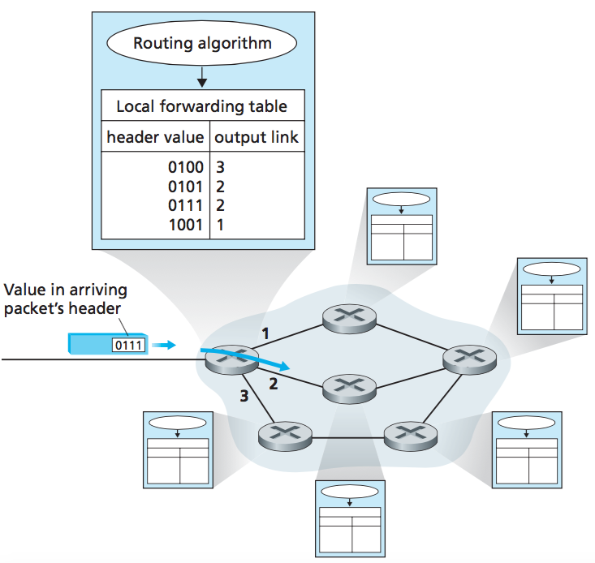
Two key network-layer functions
Interplay between forwarding and routing
Routing:
Determines end-to-end path through network
Forwarding:
Determines local forwarding for this router.
Figure: Routing algorithm determine values in forwarding tables

Slide 8
Network layer: data plane, control plane
Data plane
Forwarding function: Determines how datagram arriving on router input port is forwarded to router output port.
Local, per-router function.
Control plane
Routing function: Determines how datagram is routed among routers along end-end path from source host to destination host.
Network-wide logic.
Two Control-Plane Approaches
Traditional Routing Algorithms
SDN
values in arriving
packet header
0111
1
Implemented in routers.
(Software-Defined Networking SDN)
Implemented in server (remote)
3
2
Network Layer: 4-8

Slide 9
Datagram forwarding table
4 billion IP addresses, so rather than list individual destination address,
list range of addresses
(aggregate table entries)
routing algorithm
local forwarding table
dest address
output link
address-range 1
address-range 2
address-range 3
address-range 4
3
2
2
1
32
IPv4:
2 = 4,294,967,296
IP destination address in
arriving packet’s header
1
3
2

Slide 10
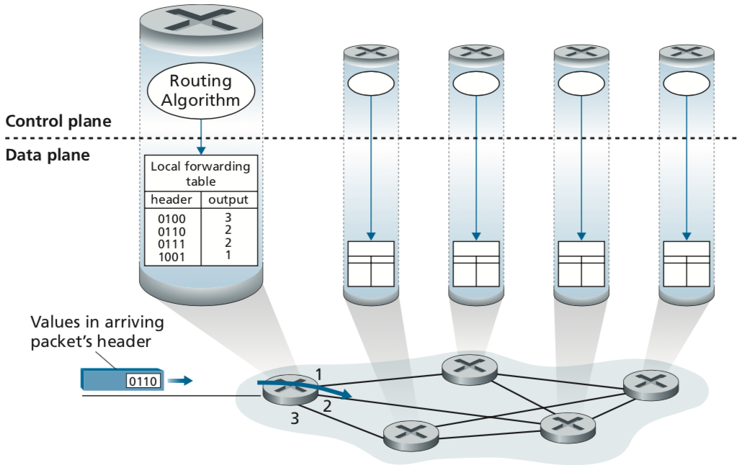
Forwarding and Routing
Per-router control plane
The Traditional Approach
Individual routing algorithm components in each and every router interact in the control plane
Routing:
Determines end-to-end path through network.
Forwarding:
Determines local forwarding of this router.
Figure: Routing algorithm determine values in forwarding tables
Kurose, J.F. and Ross, K.W. (2021). Computer Networking: A Top-Down Approach (8th Edition). Pearson Education Limited, England. (pp. 307)

Slide 11
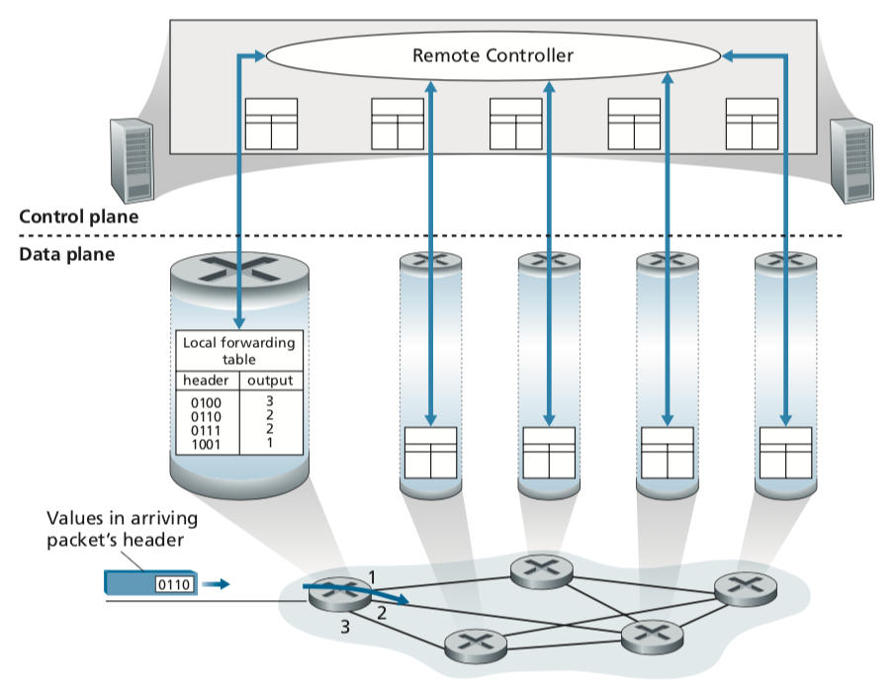
Routing:
Determines end-to-end path through network.
Forwarding and Routing
(b) The SDN Approach
Software-Defined Networking (SDN)
Remote controller computes, installs forwarding tables in routers
Forwarding:
Determines local forwarding of this router.
Figure: A remote controller determines and distributes values in forwarding tables

Slide 12
Network service model
Q: What service model for “channel” transporting datagrams from sender to receiver?
example services for individual datagrams:
guaranteed delivery
guaranteed delivery with less than 40 msec delay
example services for a flow of datagrams:
in-order datagram delivery
guaranteed minimum bandwidth to flow
restrictions on changes in inter-packet spacing

Slide 13
Network-layer service model
Network
Architecture
Internet
ATM
ATM
Internet
Internet
Quality of Service (QoS) Guarantees ?
Service
Model
best effort
Constant Bit Rate
Available Bit Rate
Intserv Guaranteed
(RFC 1633)
Diffserv (RFC 2475)
Bandwidth
none
Constant rate
Guaranteed min
yes
possible
Loss
no
yes
no
yes
possibly
Order
no
yes
yes
yes
possibly
Timing
no
yes
no
yes
no
Internet “best effort” service model
No guarantees on:
  successful datagram delivery to destination
  timing or order of delivery
  bandwidth available to end-end flow

Slide 14
Network layer service models:
Quality of Service
(QoS) Guarantees ?
Network
Architecture
Internet
ATM
ATM
ATM
ATM
Service
Model
best effort
CBR
VBR
ABR
UBR
Congestion
feedback
no (inferred
via loss)
no
congestion
no
congestion
yes
no
Bandwidth
none
constant
rate
guaranteed
rate
guaranteed
minimum
none
Loss
no
yes
yes
no
no
Order
no
yes
yes
yes
yes
Timing
no
yes
yes
no
no
Asynchronous Transfer Mode (ATM) - Network Architecture
CBR: Constant Bit Rate, VBR=Variable Bit Rate, ABR=Available Bit Rate, UBR= Unspecified Bit Rate

Slide 15
Reflections on best-effort service:
simplicity of mechanism has allowed Internet to be widely deployed adopted
sufficient provisioning of bandwidth allows performance of real-time applications (e.g., interactive voice, video) to be “good enough” for “most of the time”
replicated, application-layer distributed services (datacenters, content distribution networks) connecting close to clients’ networks, allow services to be provided from multiple locations
congestion control of “elastic” services helps
It’s hard to argue with success of best-effort service model

Slide 16
Chapter 4: data plane
4.1 Overview of Network layer
  data plane
  control plane
4.2 What’s inside a router
input ports, switching, output ports
buffer management, scheduling
4.3 IP: Internet Protocol
  datagram format
  fragmentation
  IPv4 addressing
  network address translation (NAT)
  IPv6
4.4 Generalized Forwarding and SDN
  Match+action
  OpenFlow: match+action in action

Slide 17

Router architecture overview
TWO key router functions:
run routing algorithms / protocol (RIP, OSPF, BGP)
forwarding datagrams from a router’s incoming links to the appropriate outgoing links at a router
Input Ports
Output Ports
Switching Fabric
Routing Processor
Four router components can be identified:
Router
RIP (Routing Information Protocol)
OSPF (Open-Shortest Path First)
BGP (Border Gateway Protocol)
Figure: Four router components

Slide 18
Router architecture overview
high-level view of generic router architecture:
routing, management
control plane (software)
operates in millisecond
time frame
routing
processor
forwarding data plane (hardware) operates in nanosecond timeframe
high-speed
switching
fabric
router input ports
router output ports

Slide 19
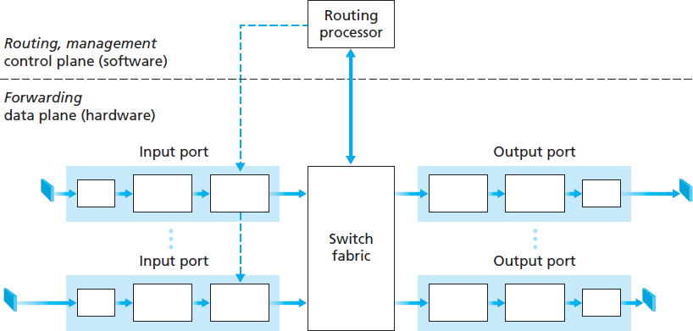
Router architecture overview
The forwarding table (FT) is computed and updated by the routing processor
a shadow copy of
FT is stored at each
input port
Why shadow copy?
forwarding decisions done locally (at input port)
avoiding bottleneck at central processor
forwarded via the
switching fabric
Packet arrives
Lookup performed
in the input port
36

Slide 20
Input port functions
lookup,
forwarding
queueing
line
termination
link
layer
protocol
(receive)
switch
fabric
physical layer:
bit-level reception
data link layer:
e.g., Ethernet
see chapter 6
decentralized switching:
using header field values, lookup output port using forwarding table in input port memory (“match plus action”)
goal: complete input port processing at ‘line speed’
queuing: if datagrams arrive faster than forwarding rate into switch fabric

Slide 21
Input port functions
lookup,
forwarding
queueing
line
termination
link
layer
protocol
(receive)
switch
fabric
physical layer:
bit-level reception
decentralized switching:
using header field values, lookup output port using forwarding table in input port memory (“match plus action”)
destination-based forwarding: forward based only on destination IP address (traditional)
generalized forwarding (SDN): forward based on any set of header field values
data link layer:
e.g., Ethernet
see chapter 6

Slide 22



Destination-based forwarding
3
Q: but what happens if ranges don’t divide up so nicely?
Network Layer: 4-22
Notes:
Text for this animation:
This all works out pretty nice and looks pretty simple!
But of course the devil is in the details, as the saying goes.
What happens, for example, when a subset of addresses say in this first range should go to say interface 3, rather than interface 0. Well, of course we could split the first address range into multiple pieces, and add in this new subrange with its new destination output port. But it turns out there’s a much simpler and elegant way to do this. Known as longest prefix matching.

Slide 23
Longest prefix matching
longest prefix match
when looking for forwarding table entry for given destination address, use longest address prefix that matches destination address.
Destination Address Range
11001000 00010111 00010
11001000 00010111 00011000
11001000 00010111 00011
otherwise
Link interface
0
1
2
3
***
********
********
***
********
examples:
11001000 00010111 00010110 10100001
which interface?
11001000 00010111 00011000 10101010
which interface?

Slide 24
Longest prefix matching
longest prefix match
when looking for forwarding table entry for given destination address, use longest address prefix that matches destination address.
Destination Address Range
11001000 00010111 00010
11001000 00010111 00011000
11001000 00010111 00011
otherwise
Link interface
0
1
2
3
***
********
********
match!
***
********
examples:
11001000 00010111 00010110 10100001
which interface?
11001000 00010111 00011000 10101010
which interface?

Slide 25
Longest prefix matching
longest prefix match
when looking for forwarding table entry for given destination address, use longest address prefix that matches destination address.
Destination Address Range
11001000 00010111 00010
11001000 00010111 00011000
11001000 00010111 00011
otherwise
Link interface
0
1
2
3
***
********
********
***
********
match!
examples:
11001000 00010111 00010110 10100001
which interface?
11001000 00010111 00011000 10101010
which interface?

Slide 26
Longest prefix matching
longest prefix match
when looking for forwarding table entry for given destination address, use longest address prefix that matches destination address.
Destination Address Range
11001000 00010111 00010
11001000 00010111 00011000
11001000 00010111 00011
otherwise
Link interface
0
1
2
3
***
********
********
***
********
match!
examples:
11001000 00010111 00010110 10100001
which interface?
11001000 00010111 00011000 10101010
which interface?

Slide 27
Longest prefix matching
we’ll see why longest prefix matching is used shortly, when we study addressing
longest prefix matching: often performed using ternary content addressable memories (TCAMs)
  content addressable: present address to TCAM: retrieve address in one clock cycle, regardless of table size
  Cisco Catalyst: can up ~1M routing table entries in TCAM

Slide 28
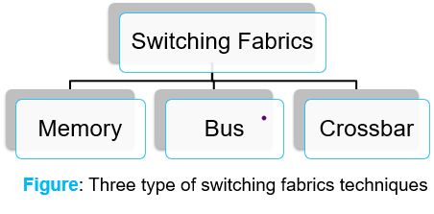
Switching Fabrics
Transfer packet from input link to appropriate output link
Switching rate: rate at which packets can be transfer from inputs to outputs
  often measured as multiple of input/output line rate.
  N inputs: switching rate = N times line rate desirable.
R
(rate: NR, ideally)
R
. . .
high-speed
switching
fabric
. . .
N input ports
N output ports
R
R

Slide 29
Switching fabrics
transfer packet from input link to appropriate output link
switching rate: rate at which packets can be transfer from inputs to outputs
  often measured as multiple of input/output line rate
  N inputs: switching rate N times line rate desirable
three types of switching fabrics
memory
memory
bus
crossbar

Slide 30
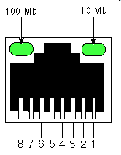
Switching via memory
first generation routers:
traditional computers with switching under direct control of CPU
packet copied to system’s memory
speed limited by memory bandwidth (2 bus crossings per datagram)
input
port
(e.g.,
Ethernet)
output
port
(e.g.,
Ethernet)
memory
system bus

Slide 31
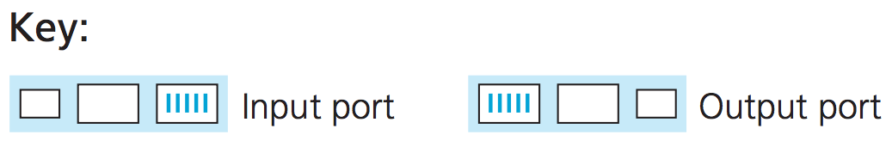
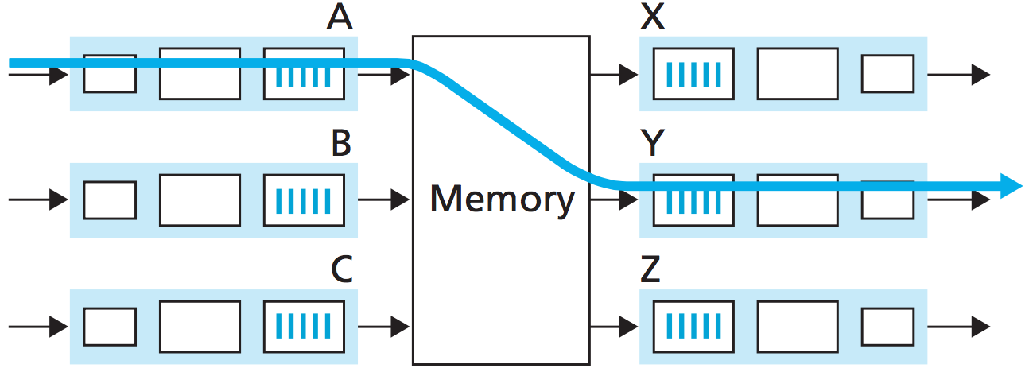
Switching via memory
Switching Fabrics
Processor copy
datagram into Memory
Datagram
arrives
Check Dest
Lookup FT
Copy datagram
to output port

Slide 32
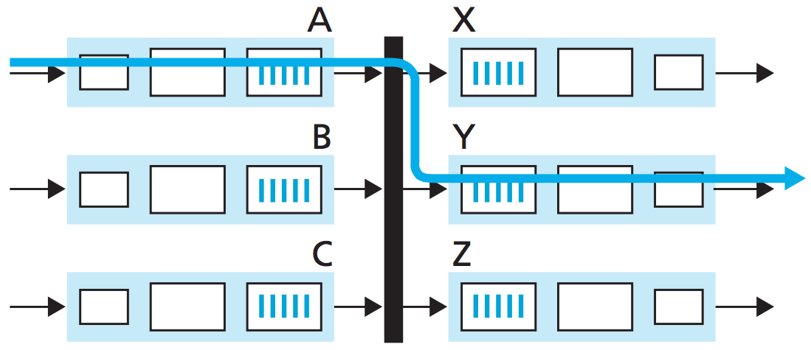
Switching via a bus
datagram from input port memory
to output port memory via a shared bus
bus contention: switching speed limited by bus bandwidth
32 Gbps bus, Cisco 5600: sufficient speed for access and enterprise routers
bus

Slide 33
Switching via a bus
Datagram gets
on bus
Datagram arrives
Datagram gets switch label
The correct output port get it → strip label → send on its ways

Slide 34
Switching via interconnection network
(crossbar)
overcome bus bandwidth limitations
Crossbar, Clos networks, other interconnection nets initially developed to connect processors in multiprocessor
multistage switch: nxn switch from multiple stages of smaller switches
3x3 crossbar
3x3 crossbar
exploiting parallelism:
  fragment datagram into fixed length cells on entry
  switch cells through the fabric, reassemble datagram at exit
8x8 multistage switch
built from smaller-sized switches

Slide 35
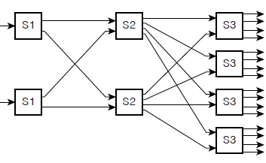
Switching via interconnection network
(crossbar)
scaling, using multiple switching “planes” in parallel:
  speedup, scaleup via parallelism
Cisco CRS router:
  basic unit: 8 switching planes
  each plane: 3-stage interconnection network
  up to 100’s Tbps switching capacity
fabric plane 0
fabric plane 1
fabric plane 2
. . .
. . .
fabric plane 3
. . .
. . .
fabric plane 4
. . .
. . .
fabric plane 5
. . .
. . .
fabric plane 6
. . .
. . .
fabric plane 7
. . .
. . .
. . .
. . .
. . .
. . .

Slide 36
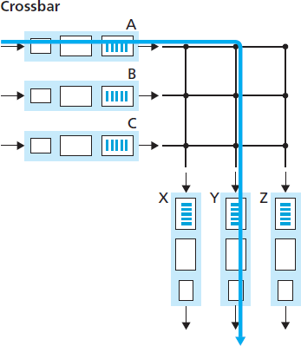
Switching via interconnection network (crossbar)
Check dest. (Y)
Datagram arrives
Close A-Y → put datagram on bus
Y picks up
datagram
45

Slide 37
Input port queuing
If fabric slower than input ports combined -> queueing may occur at input queues
  queueing delay and loss due to input buffer overflow!
Head-of-the-Line (HOL) blocking: queued datagram at front of queue prevents others in queue from moving forward
switch
fabric
switch
fabric
output port contention:
only one red datagram can be transferred.
lower red packet is blocked
one packet time later: green packet experiences HOL blocking

Slide 38
Output port queuing
datagram
buffer
queueing
switch
fabric
(rate: NR)
link
layer
protocol
(send)
line
termination
R
Buffering required when datagrams arrive from fabric faster than link transmission rate. Drop policy: which datagrams to drop if no free buffers?
Datagrams can be lost due to congestion, lack of buffers
Scheduling discipline chooses among queued datagrams for transmission
Priority scheduling – who gets best performance, network neutrality

Slide 39
Output port queueing
switch
fabric
switch
fabric
at t, packets more
from input to output
one packet time later
buffering when arrival rate via switch exceeds output line speed
queueing (delay) and loss due to output port buffer overflow!

Slide 40
How much buffering?
RFC 3439 rule of thumb:
  average buffering size = RTT * link capacity C
  e.g., RTT=250 msec (“typical”), C = 10 Gpbs link
    average buffering size =250 msec * 10 Gpbs
              = 2.5 Gbit buffer
More recent recommendation: with N flows, buffering equal to
.
RTT C
N
but too much buffering can increase delays (particularly in home routers)
  long RTTs: poor performance for realtime apps, sluggish TCP response
  recall delay-based congestion control: “keep bottleneck link just full enough
  (busy) but no fuller”

Slide 41
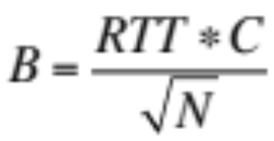
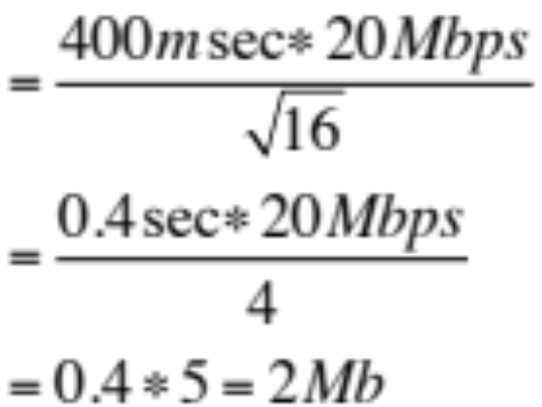
Exercise
Supposed the link capacity for a router is 20Mbps and RTT for a packet is 400msec.
If the TCP flow of packets is 16, calculate the buffering needed for the router.
Solution:
Link capacity, C = 20Mbps
RTT = 400msec
TCP flows, N = 16
Buffer size,

Slide 42
Buffer Management
buffer management:
drop: which packet to add, drop when buffers are full
  tail drop: drop arriving packet
  priority: drop/remove on priority basis
switch
fabric
datagram
buffer
queueing
scheduling
link
layer
protocol
(send)
line
termination
R
Abstraction: queue
marking: which packets to mark to signal congestion (ECN, RED)
R
packet
departures
packet
arrivals
queue
(waiting area)
link
(server)

Slide 43
Chapter 4: data plane
4.1 Overview of Network layer
  data plane
  control plane
4.2 What’s inside a router
input ports, switching, output ports
buffer management, scheduling
4.3 IP: Internet Protocol
  datagram format
  fragmentation
  IPv4 addressing
  network address translation (NAT)
  IPv6
4.4 Generalized Forwarding and SDN
  Match+action
  OpenFlow: match+action in action

Slide 44
Network Layer: Internet
host, router network layer functions:
transport layer: TCP, UDP
IP protocol
datagram format
addressing
packet handling conventions
Path-selection algorithms: implemented in
routing protocols (RIP, OSPF, BGP)
SDN controller
network
layer
forwarding
table
ICMP protocol
error reporting
router “signaling”
link layer
physical layer
RIP (Routing Information Protocol)
OSPF (Open Shortest path First)
BGP (Border Gateway Protocol)

Slide 45
IP Datagram format
32 bits
IP protocol version number
head.
len
type of
service
total datagram
length (bytes)
header length(bytes)
ver
length
“type” of service:
diffserv (0:5)
ECN (6:7)
16-bit identifier
flgs
fragment
offset
fragmentation/
reassembly
time to
live
upper
layer
header
checksum
header checksum
TTL: remaining max hops
(decremented at each router)
source IP address
32-bit source IP address
destination IP address
Maximum length: 64K bytes
Typically: 1500 bytes or less
upper layer protocol (e.g., TCP or UDP)
32-bit destination IP address
options (if any)
e.g., timestamp, record route taken
payload data
(variable length,
typically a TCP
or UDP segment)

Slide 46
IP datagram format
Understanding datagram format is important
A datagram has its own header (overhead) ➔ 20 bytes
A datagram holds TCP/UDP segment within it ➔ TCP/UDP has own overhead
overhead
20 bytes of TCP
20 bytes of IP
= 40 bytes + app layer overhead for TCP+IP
Notes:
Recall that a network-layer packet is referred to as a datagram

Slide 47
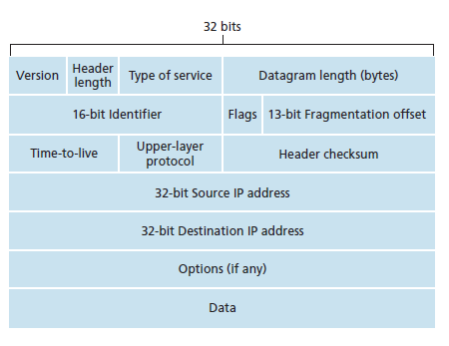
IP datagram format
IPv4 Datagram Format
20 bytes

Slide 48

IP fragmentation, reassembly
network links have MTU (max.transfer unit) - largest possible link-level frame
  different link types, different MTUs
  Ethernet MTU 1500 bytes
large IP datagram divided (“fragmented”) within net
  one datagram becomes several datagrams
  “reassembled” only at final destination
  IP header bits used to identify, order related fragments
…
fragmentation:
in: one large datagram
out: 3 smaller datagrams
reassembly
…

Slide 49
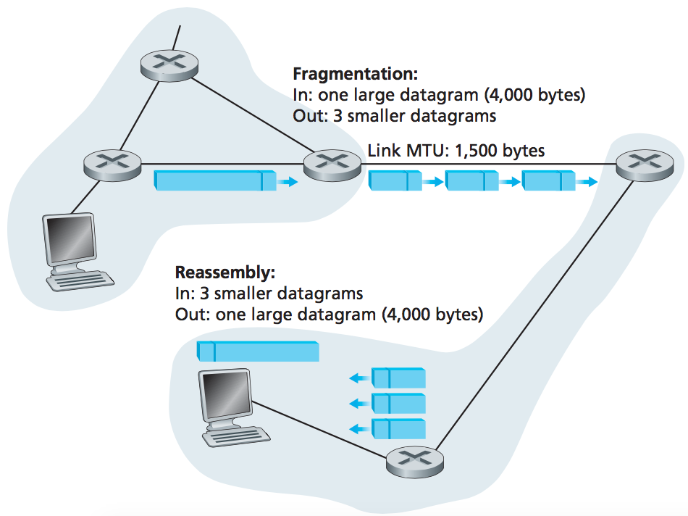
IP fragmentation, reassembly
IP fragmentation, reassembly
Original datagram :
4000 bytes
= 20 bytes of IP header
+ 3,980 bytes of IP payload
Fragmentation:
= 4000 / 1500 bytes
= 3 datagrams
Reassembly:

Slide 50
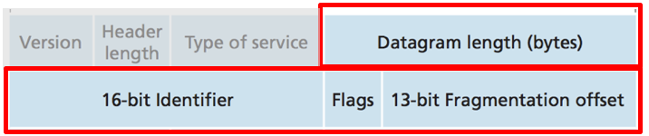
IP fragmentation, reassembly
IP fragmentation, reassembly
Fragment #1
length=1500 ID=777 flag=1 offset=0
Fragment #2
length=1500 ID=777 flag=1 offset=185
Fragment #3
length=1040 ID=777 flag=0 offset=370

Slide 51
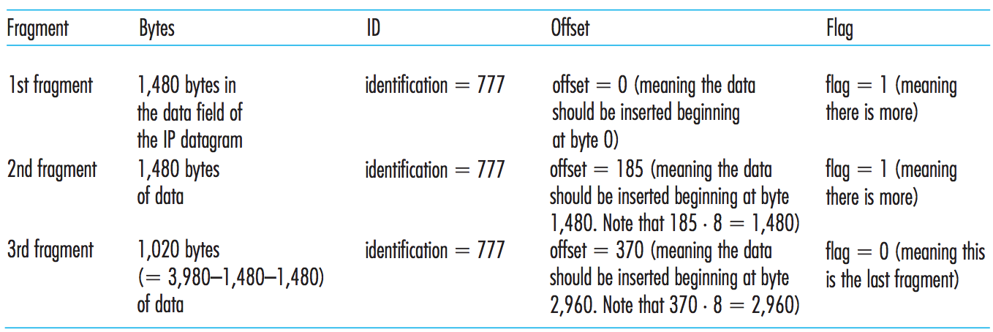
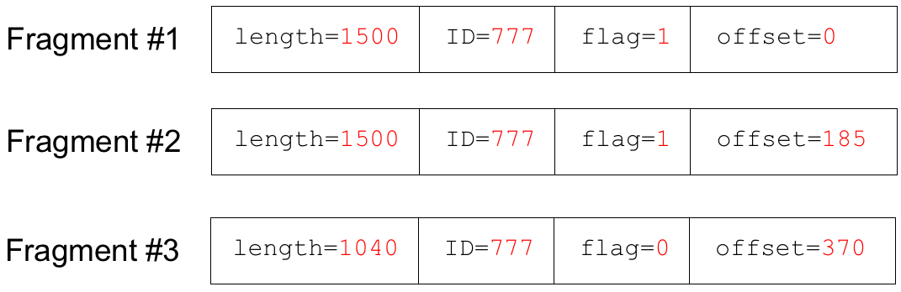
IP fragmentation, reassembly
IP fragmentation, reassembly
Data (1480) + Header (20) = 1500 bytes
Why 1480 not 1500?
offset:
0
8
...
1472
1480
...
2952
2960
...
3980
Fragment 1
0
185
370
Fragments of same datagram
Offset value specified in units of 8-byte chunks
Fragment 2
Fragment 3

Slide 52
Exercise
A datagram of 5000 bytes arrived at a router and must be forwarded to a link with an MTU of 1500 bytes. Suppose that the original datagram is stamped with an identification number of 333. Draw all IP fragments generated after fragmentation that reflect the requirement of original payload data in the datagram.
Datagram
length=5000 ID=333 flag=0 offset=0

Slide 53
Solution
Solution:
20 header + 4980 data
Datagram
length=5000 ID=333 flag=0 offset=0
Total fragments = 5000 / 1500 = 4
4980 = 1480 + 1480 + 1480 + 540
Fragment#1
length=1500 ID=333 flag=1 offset=0
Fragment#2
length=1500 ID=333 flag=1 offset=185
Fragment#3
length=1500 ID=333 flag=1 offset=370
Fragment#4
length= 560 ID=333 flag=0 offset=555

Slide 54
Chapter 4: data plane
4.1 Overview of Network layer
  data plane
  control plane
4.2 What’s inside a router
input ports, switching, output ports
buffer management, scheduling
4.3 IP: Internet Protocol
  datagram format
  fragmentation
  IPv4 addressing
  network address translation (NAT)
  IPv6
4.4 Generalized Forwarding and SDN
  Match+action
  OpenFlow: match+action in action

Slide 55
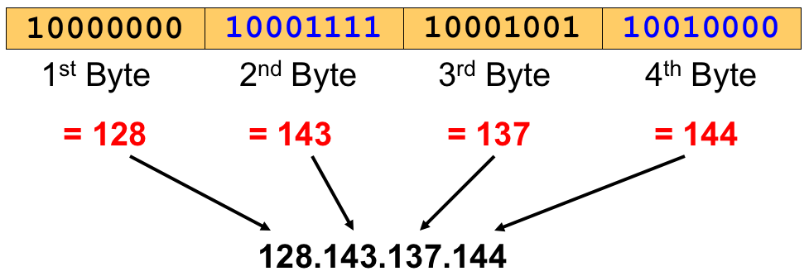
IPv4 Addressing
What is an IP Address?
IP address is used to identify a host within a network.
  are written in a so-called dotted decimal notation
  Each byte is identified by a decimal number in the range [0…255]:
Example:

Slide 56
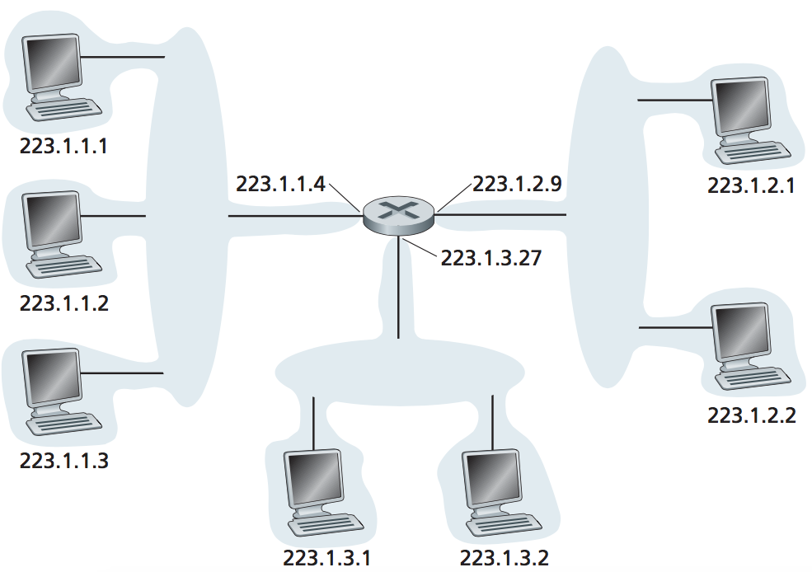
IPv4 Addressing
Addresses
IP address: 32-bit identifier for each host or router interface
Interface: connection between host/router and physical link.
  router's typically have multiple interfaces.
  host typically has one or two interfaces. (e.g., wired Ethernet, wireless 802.11)
One IP address associated with each interface !

Slide 57
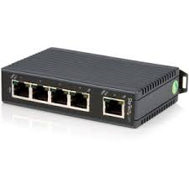
IPv4 Addressing
Addresses
Q: How are interfaces
actually connected?
A: wired Ethernet interfaces connected by Ethernet switches (Link Layer)
A: wireless WiFi interfaces connected by WiFi base station (AP – access point)

Slide 58
IPv4 Addressing – Subnet/Subnetting
Notes:
STOP HERE!!! Sec 01 – 17.04.17 ( Monday ) ; 4pm

Slide 59
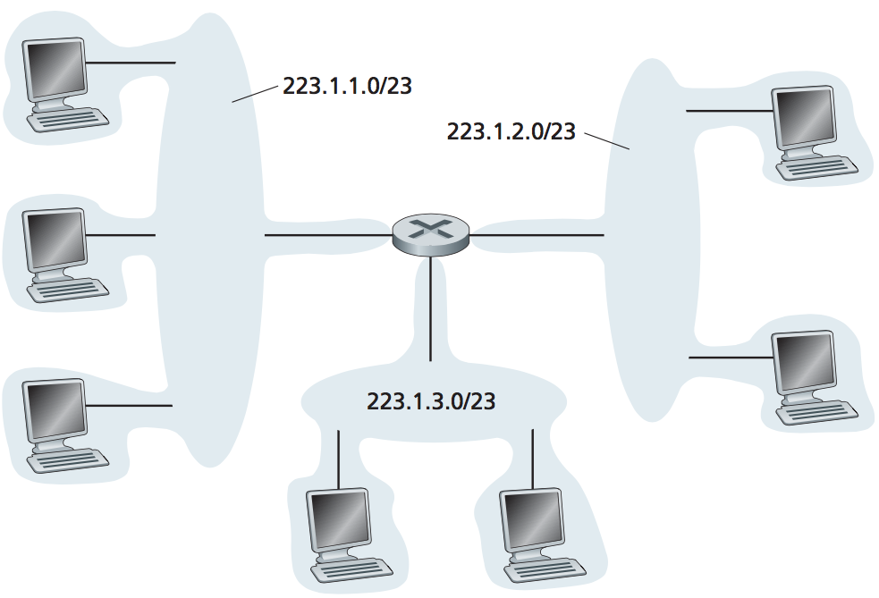
IPv4 Addressing
Subnets
  Interconnecting three host interfaces and one router interface forms a subnet.
What’s a subnet ?
device interfaces that can physically reach each other without passing through an intervening router
is a logical, visible subdivision of an IP network. The practice of dividing a network into two or more networks is called subnetting.

Slide 60
IPv4 Addressing
Subnets
A subnet is a group of host identified with having the same network portion of their IP address
Example:
  223.1.1.1, 223.1.1.2, 223.1.1.3, 223.1.1.4, …
223.1.1.1, 223.1.1.2, 223.1.1.3, 223.1.1.4, …
This network portion is indicated by the subnet mask with notation /24
Subnet mask defines the subnet address
  ➙ 223.1.1.0/24
223.1.1.0/24
223.1.2.0/24
223.1.3.0/24
Network consisting of 3 subnets

Slide 61
IPv4 Addressing
Subnet Mask
A computer OR a router must be able to identify whether a host with a given IP address is on its subnet or not.
The subnet mask is:
  used to separate the network portion of an IP address from the host portion.
  a set of 32 bits IP address which the bits in the network portion of the address are set to 1s and the host portion is set to 0s.

Slide 62
IPv4 Addressing
Subnet Mask
IP address with w.x.y.z /24 address.
8 bits 8 bits 8 bits 8 bits
11111111
11111111
11111111
00000000
Network portion
Host portion
Thus, subnet mask = 255.255.255.0

Slide 63
IPv4 Addressing
Subnet Mask
Each IP address can be divided into network portion and host portion
  Network portion (indicated by subnet mask)
    all host with same network portion are in the same subnet
    these host can physically reach each other without intervening router
  Host portion (the remaining bits → {32 bits – subnet mask })
    The individual (unique) address for a host
  Example: 192.64.22.31/24
192
64
22
31
11000000 . 01000000 . 00010110 . 00011111
Network portion
Host portion

Slide 64
IPv4 Addressing
Example
Subnet Mask
Convert these subnet mask into decimal values.
(a) /8
(b) /16
(c) /24
(d) /25
11111111.00000000.00000000.00000000
255.0.0.0
11111111.11111111.00000000.00000000
255.255.0.0
11111111.11111111.11111111.00000000
255.255.255.0
11111111.11111111.11111111.10000000
255.255.255.128

Slide 65
IPv4 Addressing
192.64.22.31/24
192
64
22
31
11000000 . 01000000 . 00010110 . 00011111
Network portion
Host portion
Given the information we find that:
  The host portion has 8 bits →
    this subnet can have up to 2⁸ = 256 hosts
    With IP addresses ranging from 192.64.22.0 – 192.64.22.255
  But the first and last IP address cannot be assigned to host
    so only 254 hosts available (or usable)
    …thus useable IP addresses → 192.64.22.1 – 192.64.22.254
  The first IP – becomes network address → to address the subnet
  The last IP – becomes broadcast address → used to broadcast info throughout the subnet

Slide 66
IPv4 Addressing
Subnet Network Address (Binary Method) and Broadcast Address
Given an IP address and subnet mask, we can find the network address and broadcast address …
Example: IP address = 192.168.1.10/24
  Set the host portion as all zero(0) to get network address
  Set the host portion as all one(1) to get broadcast address
192.168.1.10
Network address: 192.168.1.0
192.168.1.[00000000]
192.168.1.[11111111]
Broadcast address: 192.168.1.255

Slide 67
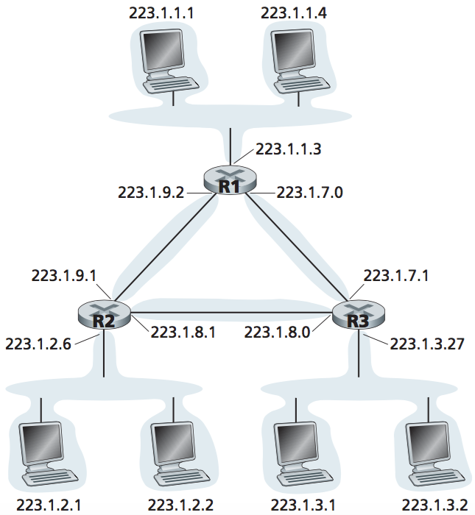
IPv4 Addressing
Subnet Network Address (AND Method)
To determine subnet address:
IP address AND subnet mask
223.1.1.0/24
Example:
If the subnet mask is 255.255.255.0, define the subnet address.
(AND)
223. 1 . 1 .4
AND 255.255.255.0
11011111.00000001.00000001.00000100
11111111.11111111.11111111.00000000
11011111.00000001.00000001.00000000
223.1.1.0/24

Slide 68


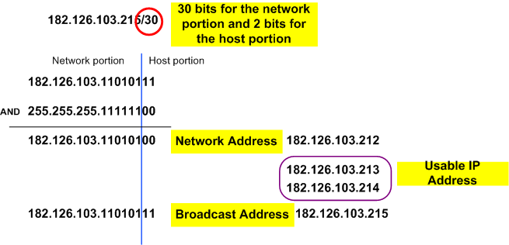
IPv4 Addressing
Example
182.126.103.215/30
Network portion of the address DOES NOT CHANGE.

Slide 69
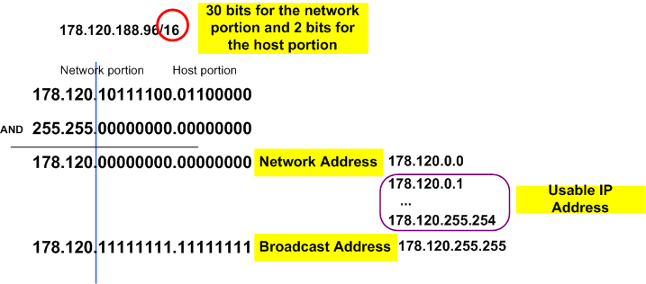
IPv4 Addressing
Example
178.120.188.96/16
16 bits for the network portion and 16 bits for host portion
Network portion of the address DOES NOT CHANGE.

Slide 70
Class Exercise
Given these IP addresses, determine the network portion and the host portion
  192.168.12.0/24
  192.168.12.25/25
  172.16.32.0/16
  172.16.32.0/20
  10.10.10.0/8
In-class try out ...

Slide 71
IPv4 Addressing – Type of Addressing
Type of Addressing
Classful ( old one)
Classless (CIDR) ( current)

Slide 72
Classful Addressing
In the beginning, addressing scheme known as classful addressing →
  where IP blocks were given according to size
  Class A – big size of organization
  Class B – medium size of organization
  Class C – small size of organization

Slide 73
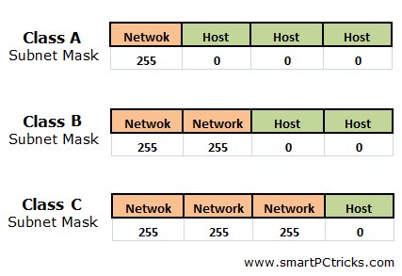
Classful addressing

Slide 74
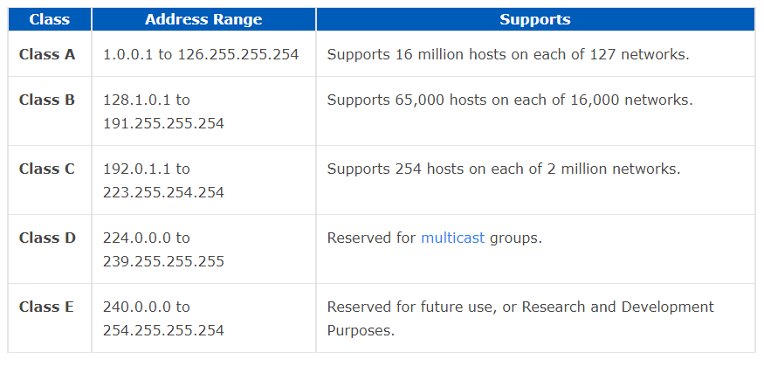
Classful addressing
/8 255.0.0.0
/16 255.255.0.0
/24 255.255.255.0

Slide 75
Classful addressing
  Example:
  An organization needs 2000 hosts and apply class B
  Class B allocated 65000 addresses, and leaving more than 63000 not used.
  PROBLEMS: Wasted addresses and not optimized
  Large organizations do not fully utilize the IP address they have
  Had problem supporting the rapidly growing number of organizations with small and medium-sized subnets

Slide 76
Classless Inter Domain Routing (CIDR)
  more flexible than original system of internet address scheme (classful addressing), subnet portion of address of arbitrary length
  can avoid situations where large numbers of IP addresses are unused
  address format: a.b.c.d/x
where x is no. of bits in subnet portion of address often referred to as prefix
200.23.16.0/23
11001000.00010111.00010000.00000000
Subnet part
host
part
Network part

Slide 77
Classless Inter Domain Routing (CIDR)
Example:
  An organization needs 2000 hosts and apply for IP address
  Host needed is 2000 → 2¹¹ = 2048 (i.e. only extra 48)
  Thus an IP address→ 163.44.224.0/21 is given
    How we get … /21 ? → 32 – 11 = 21
21 bits 11 bits
11111111
11111111
11111
00000000000
Network portion
Host portion

Slide 78
Subnetting: To subnet a small network
Q: How does a network get subnets part of an IP address?
A: by subnetting the given IP address
Example: 200.23.16.0/20 to be divided into 8 subnets (2³).
need to borrow 3 bits
from host portion
to define 8 subnets
ISP’s block:
200.23.16.0/20 →
Network portion
Host portion
11001000.00010111.00010000.00000000
Subnet 0:
200.23.16.0/23 →
11001000.00010111.00010000.00000000
Subnet 1:
200.23.18.0/23 →
11001000.00010111.00010010.00000000
…
Subnet 7:
200.23.30.0/23 →
...
11001000.00010111.00011110.00000000

Slide 79
Subnetting (Example): To subnet
a small network
Say, Company A (CA) is given the IP address 192.168.1.0/24
CA has 4 departments under it:
  RND
  Sales
  Finance
  Human Resource (HR)
CA decided to divide the network according to purpose. So, the network needs to have 4 subnets.

Slide 80
Subnetting (Example): To subnet
a small network
192.168.1.0/24 to be divided into 4 subnets
192.168.1.0/24 →
11000000.10101000.00000001.00000000

Slide 81
Subnetting (Example): To subnet
a small network
192.168.1.0/24 to be divided into 4 subnets
Network portion
Host portion
192.168.1.0/24 →
11000000.10101000.00000001.00000000
Subnet address: →
11000000.10101000.00000001.00000000
need to borrow 2 bits
from host portion
to define 4 subnets
(i.e. 2²)

Slide 82
Subnetting (Example): To subnet
a small network
192.168.1.0/24 to be divided into 4 subnets
Network portion
Host portion
192.168.1.0/24 →
11000000.10101000.00000001.00000000
Subnet address: →
11000000.10101000.00000001.00000000
Subnet 0: →
192.168.1.0/26
11000000.10101000.00000001.00000000
6 bit left for host
The subnet mask for each subnet
is /26 OR 255.255.255.192

Slide 83
Subnetting (Example): To subnet
a small network
Subnet 0: →
192.168.1.0/26
11000000.10101000.00000001.00000000
192.168.1.[ 00 000000 ]
.[ 00 111111 ]
.[ 01 000000 ]
.[ 01 111111 ]
.[ 10 000000 ]
.[ 10 111111 ]
.[ 11 000000 ]
.[ 11 111111 ]
subnet 0
subnet 1
subnet 2
subnet 3

Slide 84
Subnetting (Example): To subnet
a small network
Subnet 0: →
192.168.1.0/26
11000000.10101000.00000001.00000000
192.168.1.[ 00 000000 ]
.[ 00 111111 ]
.[ 01 000000 ]
.[ 01 111111 ]
.[ 10 000000 ]
.[ 10 111111 ]
.[ 11 000000 ]
.[ 11 111111 ]
subnet 0; network address = 192.168.1.0
subnet 1; network address = 192.168.1.64
subnet 2; network address = 192.168.1.128
subnet 3; network address = 192.168.1.192

Slide 85
Subnetting (Example): To subnet
a small network
Subnet 0: →
192.168.1.0/26
11000000.10101000.00000001.00000000
192.168.1.[ 00 000000 ]
.[ 00 111111 ]
.[ 01 000000 ]
.[ 01 111111 ]
.[ 10 000000 ]
.[ 10 111111 ]
.[ 11 000000 ]
.[ 11 111111 ]
subnet 0; broadcast address = 192.168.1.63
subnet 1; broadcast address = 192.168.1.127
subnet 2; broadcast address = 192.168.1.191
subnet 3; broadcast address = 192.168.1.255

Slide 86
Subnetting (Example): To subnet
a small network
Subnet 0: →
192.168.1.0/26
11000000.10101000.00000001.00000000
192.168.1.[ 00 000000 ]
.[ 00 111111 ]
.[ 01 000000 ]
.[ 01 111111 ]
.[ 10 000000 ]
.[ 10 111111 ]
.[ 11 000000 ]
.[ 11 111111 ]
00 000001 – first host
00 111110 – last host
01 000001 – first host
01 111110 – last host
10 000001 – first host
10 111110 – last host
11 000001 – first host
11 111110 – last host

Slide 87
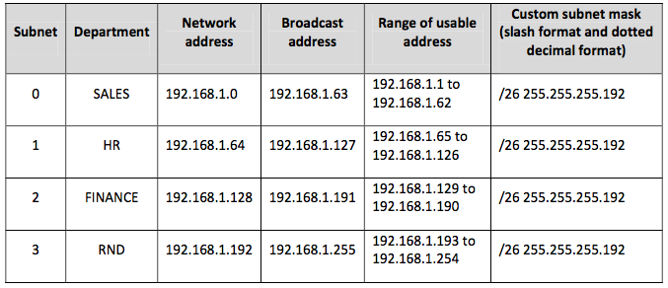
Subnetting (Example): To subnet
a small network
192.168.1.0/24 be divided into 4 subnets we get:

Slide 88
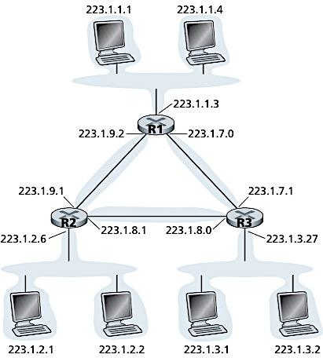
Self study
Exercise
A
B
Given a network with hosts and interconnecting routers.
What are the subnet mask for the network that consists of host A, B, D and E?
What is the subnet network address of X if the subnet mask is 255.0.0.0?
Get first valid usable IP address for host A, B, D, E and G.
Get last valid usable IP address for each router’s interface at C and F.
200.1.0.0/16
C
F
161.139.2.0/24
X
D E G
10.90.2.1

Slide 89
Self study
Solution
A
B
Net. consists of host A, B:
255.255.0.0
Net. consists of host D, E:
255.255.255.0
(b) 10.90.2.1
255. 0.0.0
10. 0.0.0
First valid usable IP address:
A: 200.1.0.1
B: 200.1.0.2
D: 161.139.2.1
E: 161.139.2.2
G: 10.90.2.2
(d) Last valid usable IP address:
C: 200.1.255.254
F: 161.139.2.254
200.1.0.0/16
C
F
161.139.2.0/24
X
D E G
10.90.2.1

Slide 90
Self study
Exercise
Given an IP address as 200.23.0.0/20. The network need to be divided into 5 subnets with first subnet label as Subnet 0 and last subnet label as Subnet 4.
What is the original subnet mask for the given IP address network?
How many hosts can be supported in the original IP address network?
List all new subnet address in binary and dotted decimal format.
What is the new subnet mask for each subnet?
How many hosts can be supported for each new subnet?
List the first 5 valid IP addresses for the Subnet 3.
How many subnet remain unused and can be utilized in future?

Slide 91
Self study
Solution
Solutions:
11111111.11111111.11110000.00000000
255.255.240.0
(b) Total original hosts → 2¹² – 2 = 4096 – 2 = 4094 hosts (12 bit for host portion)
(c) Number of Subnets Needed = 5 → nearest 2³ = 8 subnets; 3 bits for subnet;
11001000.00010111.00000000.00000000 (200.23.0.0/23)
11001000.00010111.00000010.00000000 (200.23.2.0/23)
11001000.00010111.00000100.00000000 (200.23.4.0/23)
11001000.00010111.00000110.00000000 (200.23.6.0/23)
11001000.00010111.00001000.00000000 (200.23.8.0/23)
11001000.00010111.00001010.00000000 (200.23.10.0/23)
11001000.00010111.00001100.00000000 (200.23.12.0/23)
11001000.00010111.00001110.00000000 (200.23.14.0/23)

Slide 92
Self study
Solution
Solutions:
(d) 11111111.11111111.11111110.00000000
255.255.254.0
(e) Total hosts in new subnet → 2⁹ = 512 – 2 = 510 hosts (9 bits for host portion)
(f) Subnet 3 = 200.23.6.0/23
11001000.00010111.00000110.00000001 (200.23.6.1/23)
11001000.00010111.00000110.00000010 (200.23.6.2/23)
11001000.00010111.00000110.00000011 (200.23.6.3/23)
11001000.00010111.00000110.00000100 (200.23.6.4/23)
11001000.00010111.00000110.00000101 (200.23.6.5/23)
(g) Need 5 subnets, generated subnets = 8, extra = 8 – 5 = 3 subnets for future use

Slide 93
Extra Exercise: Subnet small network
Say, Company A (CA) is given the Network address 192.168.1.0/24
CA has 4 departments under it: RND, Sales, Finance, HR
Each department needs the following number of usable host: RND(50), Sales(30), Finance(20), HR(10)
Task:
  Divide equally for all dept. (same/equal size)

Slide 94
Network address 192.168.1.0/24
to divide into SAME/EQUAL SIZED 4 dept : RND, SALES, FIN, HR
STEP 1 : Divide the Network and host portion (HP)
192 . 168 . 1 . 0
11000000 . 10101000.00000001.00000000
NP = 24 bits
**when subnetting ONLY HOST PORTION
is borrowed from (disturbed)
STEP 2 : Decide how many bits need to BORROW from HP?
4 depts. ➔ 4 subnet
So 2^{x} = 4 ➔ x = 2 bits
Borrow 2 bits

Slide 95
Network address 192.168.1.0/24
to divide into SAME/EQUAL SIZED 4 dept : RND, SALES, FIN, HR
Borrow from this end – THE LEFTMOST
STEP 3 : Borrow 2 bits from the host portion
192 . 168 . 1 . 0
11000000 . 10101000.00000001.00000000
Within the subnet , the HP gets all 0 and all 1
STEP 4 : Arrange the new subnets
192 . 168 . 1 . 0
11000000 . 10101000.00000001.00000000 [0]
.00111111 [63]
.01000000 [64]
.01111111 [127]
.10000000 [128]

Slide 96
Network address 192.168.1.0/24
to divide into SAME/EQUAL SIZED 4 dept : RND, SALES, FIN, HR
STEP 4 : Arrange the new subnets
S0 Network Add
192 . 168 . 1 . 0
11000000 . 10101000.00000001.00000000
S0
.00111111
.01 000000
.01 111111
.10 000000
.10 111111
.11 000000
.11 111111
S0 Broadcast Add
S1
S0 (Subnet 0)
network address:
192.168.1.0
Broadcast address:
192.168.1.63
S2
S3

Slide 97
Network address 192.168.1.0/24
to divide into SAME/EQUAL SIZED 4 dept : RND, SALES, FIN, HR
S0 (Subnet 0)
Usable/valid IP address:
192.168.1.1 to
192.168.1.62
STEP 5 : Assign the new subnets
192 . 168 . 1 . 0
11000000 . 10101000.00000001.00000000
000001
111110
S0 - RND
.00111111
.01 000000
.01 111111
.10 000000
.10 111111
.11 000000
.11 111111
S1 - SALES
000001
111110
S2 - FIN
000001
111110
S3 - HR
000001
111110

Slide 98
STEP 6 : Complete the subnetting table
SUBNET | NETWORK ADDRESS | USABLE/VALID IP ADD. RANGE | BROADCAST ADDRESS | SUBNET MASK
0 | 192.168.1.0 | 192.168.1.1 – 192.168.1.62 | 192.168.1.63 | /26 OR 255.255.255.192
1 | 192.168.1.64 | 192.168.1.65 – 192.168.1.126 | 192.168.1.127 | /26 OR 255.255.255.192
2 | 192.168.1.128 | 192.168.1.126 – 192.168.1.190 | 192.168.1.191 | /26 OR 255.255.255.192
3 | 192.168.1.192 | 192.168.1.190 – 192.168.1.254 | 192.168.1.255 | /26 OR 255.255.255.192
Convert calculation in table to binary format for complete understanding

Slide 99


Obtaining a block of addresses (network address)
Q: How does a network get IP address block for itself (network part of address)
A: ICANN: Internet Corporation for Assigned Names and Numbers (http://www.icann.org/)
  allocates addresses
  manages DNS
  assigns domain names, resolves disputes
ICANN allocates addresses to 5 regional Internet registries (RRs)
  like ARIN, RIPE, APNIC, and LACNIC
  …which handle the allocation/management of addresses within their regions.

Slide 100
Obtaining a host addresses
Q: How does a host get IP address within its network (host part of address)?
A: local ISP (e.g. Telekom, Celcom, DiGi, Maxis) & local organization like UTM:
DHCP: Dynamic Host Configuration Protocol: dynamically get address from server. “plug-and-play” concept
OR
hard-coded by sysadmin in config file (e.g., /etc/rc.config in UNIX)

Slide 101
Dynamic Host Configuration Protocol (DHCP)
In an organization, IP address can be assigned to host
  Statically – User manually configure IP address at host (normally done by ‘network admin’)
  Dynamically - done using DHCP
DHCP can be configured to assign
  the same IP address to a given host each time it connects to the network
  OR
  different IP address each time the host connects to the network.

Slide 102
Dynamic Host Configuration Protocol (DHCP)
Goal: allow host to dynamically obtain its IP address from DHCP server when it joins network
  host will lease an IP address, can renew its lease on address in use
  allows reuse of addresses (only hold address while connected/on)
  support for mobile users who want to join/leave network
DHCP is a plug-and-play protocol
  Makes network admin job easier
  Makes network mobility easier too

Slide 103
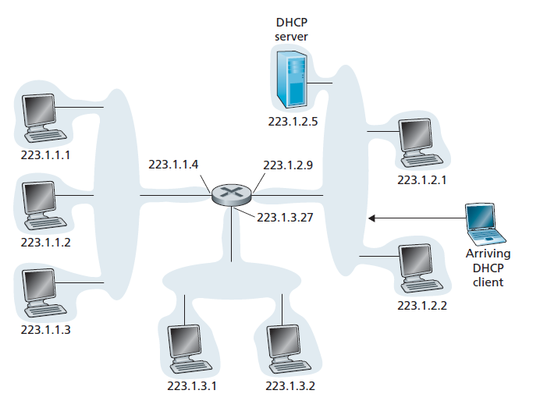
Dynamic Host Configuration Protocol (DHCP)
A newly arriving host, goes through the DHCP protocol four-step process

Slide 104


DHCP client-server scenario
DHCP
server
223.1.1.0/24
223.1.1.1
223.1.2.1
223.1.1.2
arriving DHCP
client needs
address in this
network
223.1.1.4
223.1.2.9
223.1.3.27
223.1.2.2
223.1.1.3
223.1.2.0/24
223.1.3.1
223.1.3.2
DHCP can return more than just allocated IP address on subnet:
  address of first-hop router for client
  name and IP address of DNS sever
  network mask (indicating network versus host portion of address)
223.1.3.0/24

Slide 105
DHCP – 4 Steps Process
DHCP overview:
  host broadcasts DHCP discover msg [optional]
  DHCP server responds with DHCP offer msg [optional]
  host requests IP address: DHCP request msg
  DHCP server sends address: DHCP ack msg
DHCP 4 steps process
  DHCP server discovery
  DHCP server offer
  DHCP request
  DHCP ACK
Notes:
DHCP overview:
host broadcasts “DHCP discover” msg [optional]
DHCP server responds with “DHCP offer” msg [optional]
host requests IP address: “DHCP request” msg
DHCP server sends address: “DHCP ack” msg

Slide 106
DHCP – 4 Steps Process
DHCP server discovery
  newly arriving host needs to find a DHCP server
  → done by broadcasting the DHCP discover message
    source: this host 0.0.0.0
    dest: 255.255.255.255 (i.e. broadcast to all)
    UDP: Port 67
DHCP server offer
  DHCP server(s) will respond to the client with a DHCP offer message that is broadcast to all
  A client might receive offers from > 1 DHCP servers

Slide 107
DHCP – 4 Steps Process
DHCP request
  Client choose from among the offers
  Respond to its selected offer with a DHCP request message.
DHCP ACK
  The server responds to the DHCP request message with a DHCP ACK message, confirming the requested parameters.
Notes:
In DHCP request message, the client echoes back the configuration parameters.
DHCP can return more than just allocated IP address on subnet:
address of first-hop router for client
name and IP address of DNS sever
network mask (indicating network versus host portion of address)

Slide 108
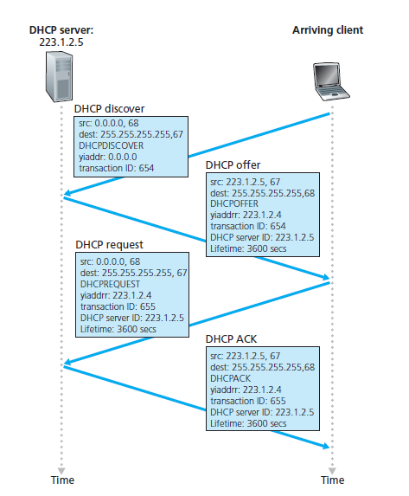
DHCP – 4 Steps Process
yiaddr = your IP address

Slide 109

DHCP client-server scenario
DHCP server: 223.1.2.5
DHCP discover
arriving
client
src : 0.0.0.0, 68
dest.: 255.255.255.255,67
yiaddr: 0.0.0.0
transaction ID: 654
Broadcast: is there a DHCP server out there?
DHCP offer
src: 223.1.2.5, 67
dest: 255.255.255.255, 68
yiaddrr: 223.1.2.4
transaction ID: 654
lifetime: 3600 secs
Broadcast: I’m a DHCP server! Here’s an IP address you can use
DHCP request
src: 0.0.0.0, 68
dest:: 255.255.255.255, 67
yiaddrr: 223.1.2.4
transaction ID: 655
lifetime: 3600 secs
Broadcast: OK. I’ll take that IP address!
DHCP ACK
src: 223.1.2.5, 67
dest: 255.255.255.255, 68
yiaddrr: 223.1.2.4
transaction ID: 655
lifetime: 3600 secs
Broadcast: OK. You’ve got that IP address!

Slide 110


DHCP: example
DHCP
DHCP
UDP
IP
Eth
Phy
Connecting laptop will use DHCP to get IP address, address of first-hop router, address of DNS server.
DHCP
DHCP
DHCP
DHCP
DHCP REQUEST message encapsulated in UDP, encapsulated in IP, encapsulated in Ethernet
DHCP
DHCP
UDP
IP
Eth
Phy
168.1.1.1
DHCP
DHCP
DHCP
Ethernet frame broadcast (dest: FFFFFFFFFFFF) on LAN, received at router running DHCP server
DHCP
router with DHCP
server built into
router
Ethernet demux’ed to IP demux’ed, UDP demux’ed to DHCP

Slide 111
DHCP: example
DHCP
DHCP
UDP
IP
Eth
Phy
DCP server formulates DHCP ACK containing client’s IP address, IP address of first-hop router for client, name & IP address of DNS server
DHCP
DHCP
DHCP
encapsulated DHCP server reply forwarded to client, demuxing up to DHCP at client
DHCP
DHCP
UDP
IP
Eth
Phy
DHCP
DHCP
DHCP
router with DHCP
server built into
router
DHCP
client now knows its IP address, name and IP address of DNS server, IP address of its first-hop router

Slide 112
DHCP: Example Wireshark output (home LAN)
request
reply
Message type: Boot Request (1)
Hardware type: Ethernet
Hardware address length: 6
Hops: 0
Transaction ID: 0x6b3a11b7
Seconds elapsed: 0
Bootp flags: 0x0000 (Unicast)
Client IP address: 0.0.0.0 (0.0.0.0)
Your (client) IP address: 0.0.0.0 (0.0.0.0)
Next server IP address: 0.0.0.0 (0.0.0.0)
Relay agent IP address: 0.0.0.0 (0.0.0.0)
Client MAC address: Wistron_23:68:8a (00:16:d3:23:68:8a)
Server host name not given
Boot file name not given
Magic cookie: (OK)
Option: (t=53,l=1) DHCP Message Type = DHCP Request
Option: (61) Client identifier
Length: 7; Value: 010016D323688A;
Hardware type: Ethernet
Client MAC address: Wistron_23:68:8a (00:16:d3:23:68:8a)
Option: (t=50,l=4) Requested IP Address = 192.168.1.101
Option: (t=12,l=5) Host Name = "nomad"
Option: (55) Parameter Request List
Length: 11; Value: 010F03062C2E2F1F21F92B
1 = Subnet Mask; 15 = Domain Name
3 = Router; 6 = Domain Name Server
44 = NetBIOS over TCP/IP Name Server
……
Message type: Boot Reply (2)
Hardware type: Ethernet
Hardware address length: 6
Hops: 0
Transaction ID: 0x6b3a11b7
Seconds elapsed: 0
Bootp flags: 0x0000 (Unicast)
Client IP address: 192.168.1.101 (192.168.1.101)
Your (client) IP address: 0.0.0.0 (0.0.0.0)
Next server IP address: 192.168.1.1 (192.168.1.1)
Relay agent IP address: 0.0.0.0 (0.0.0.0)
Client MAC address: Wistron_23:68:8a (00:16:d3:23:68:8a)
Server host name not given
Boot file name not given
Magic cookie: (OK)
Option: (t=53,l=1) DHCP Message Type = DHCP ACK
Option: (t=54,l=4) Server Identifier = 192.168.1.1
Option: (t=1,l=4) Subnet Mask = 255.255.255.0
Option: (t=3,l=4) Router = 192.168.1.1
Option: (6) Domain Name Server
Length: 12; Value: 445747E2445749F244574092;
IP Address: 68.87.71.226;
IP Address: 68.87.73.242;
IP Address: 68.87.64.146
Option: (t=15,l=20) Domain Name = "hsd1.ma.comcast.net."

Slide 113
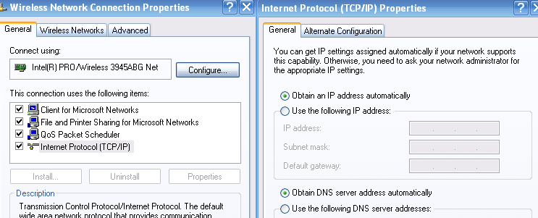
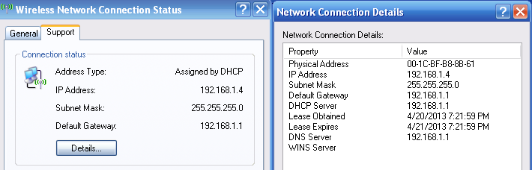
DHCP: Example Assignment (home LAN)
TCP/IP Client Setting
DHCP Server Assignment

Slide 114
Hierarchical addressing: route aggregation
hierarchical addressing allows efficient advertisement of routing information:
Organization 0
200.23.16.0/23
Organization 1
200.23.18.0/23
“Send me anything
with addresses
beginning
200.23.16.0/20”
Organization 2
200.23.20.0/23
.
Fly-By-Night-ISP
.
.
.
.
Internet
Organization 7
.
200.23.30.0/23
ISPs-R-Us
“Send me anything
with addresses
beginning
199.31.0.0/16”

Slide 115
Hierarchical addressing: more specific routes
Organization 1 moves from Fly-By-Night-ISP to ISPs-R-Us
ISPs-R-Us now advertises a more specific route to Organization 1
Organization 0
200.23.16.0/23
“Send me anything
with addresses
beginning
200.23.16.0/20”
Organization 2
200.23.20.0/23
.
Fly-By-Night-ISP
.
.
.
.
Internet
Organization 7
.
200.23.30.0/23
ISPs-R-Us
“Send me anything
with addresses
beginning 199.31.0.0/16
or 200.23.18.0/23”
Organization 1
200.23.18.0/23

Slide 116
Hierarchical addressing: more specific routes
Organization 1 moves from Fly-By-Night-ISP to ISPs-R-Us
ISPs-R-Us now advertises a more specific route to Organization 1
Organization 0
200.23.16.0/23
“Send me anything
with addresses
beginning
200.23.16.0/20”
Organization 2
.
200.23.20.0/23
.
Fly-By-Night-ISP
.
.
Internet
.
Organization 7
.
200.23.30.0/23
ISPs-R-Us
“Send me anything
with addresses
beginning
199.31.0.0/16”
Organization 1
200.23.18.0/23
“or 200.23.18.0/23”

Slide 117
Chapter 4: data plane
4.1 Overview of Network layer
  data plane
  control plane
4.2 What’s inside a router
input ports, switching, output ports
buffer management, scheduling
4.3 IP: Internet Protocol
  datagram format
  fragmentation
  IPv4 addressing
  network address translation (NAT)
  IPv6
4.4 Generalized Forwarding and SDN
  Match+action
  OpenFlow: match+action in action

Slide 118
NAT: network address translation
Q: are there enough 32-bit IP addresses?
ICANN allocated last chunk of IPv4 addresses to RRs in 2011
NAT (next) helps IPv4 address space exhaustion
IPv6 has 128-bit address space
"Who the hell knew how much address space we needed?" Vint Cerf (reflecting on decision to make IPv4 address 32 bits long)

Slide 119
NAT: network address translation
NAT: all devices in local network share just one IPv4 address as far as outside world is concerned
rest of
Internet
local network (e.g., home network) 10.0.0/24
138.76.29.7
10.0.0.4
10.0.0.1
10.0.0.2
10.0.0.3
all datagrams leaving local network have same source NAT IP address: 138.76.29.7, but different source port numbers
datagrams with source or destination in this network have 10.0.0/24 address for source, destination (as usual)

Slide 120
NAT: network address translation
  all devices in local network have 32-bit addresses in a “private” IP address space (10/8, 172.16/12, 192.168/16 prefixes) that can only be used in local network
  advantages:
    just one IP address needed from provider ISP for all devices
    can change addresses of host in local network without notifying outside world
    can change ISP without changing addresses of devices in local network
    security: devices inside local net not directly addressable, visible by outside world

Slide 121
NAT: network address translation
implementation: NAT router must (transparently):
  outgoing datagrams: replace (source IP address, port #) of every outgoing datagram to (NAT IP address, new port #)
      remote clients/servers will respond using (NAT IP address, new port #) as destination address
  remember (in NAT translation table) every (source IP address, port #) to (NAT IP address, new port #) translation pair
  incoming datagrams: replace (NAT IP address, new port #) in destination fields of every incoming datagram with corresponding (source IP address, port #) stored in NAT table

Slide 122
NAT: network address translation
NAT translation table
WAN side addr LAN side addr
2: NAT router
changes datagram
source addr from
10.0.0.1, 3345 to
138.76.29.7, 5001,
updates table
1: host 10.0.0.1
sends datagram to
128.119.40.186, 80
138.76.29.7, 5001 10.0.0.1, 3345
…… ……
S: 10.0.0.1, 3345
D: 128.119.40.186, 80
10.0.0.1
1
2
S: 138.76.29.7, 5001
D: 128.119.40.186, 80
10.0.0.4
10.0.0.2
138.76.29.7
S: 128.119.40.186, 80
D: 10.0.0.1, 3345
4
S: 128.119.40.186, 80
D: 138.76.29.7, 5001
3
10.0.0.3
4: NAT router
changes datagram
dest addr from
138.76.29.7, 5001 to 10.0.0.1, 3345
3: reply arrives
dest. address:
138.76.29.7, 5001
* Check out the online interactive exercises for more examples: http://gaia.cs.umass.edu/kurose_ross/interactive/

Slide 123
NAT: network address translation
NAT has been controversial:
  routers “should” only process up to layer 3
  address “shortage” should be solved by IPv6
  violates end-to-end argument (port # manipulation by network-layer device)
  NAT traversal: what if client wants to connect to server behind NAT?
but NAT is here to stay:
  extensively used in home and institutional nets, 4G/5G cellular nets

Slide 124
Chapter 4: data plane
4.1 Overview of Network layer
  data plane
  control plane
4.2 What’s inside a router
input ports, switching, output ports
buffer management, scheduling
4.3 IP: Internet Protocol
  datagram format
  fragmentation
  IPv4 addressing
  network address translation (NAT)
  IPv6
4.4 Generalized Forwarding and SDN
  Match+action
  OpenFlow: match+action in action

Slide 125
IPv6: motivation
initial motivation: 32-bit IPv4 address space soon to be completely allocated. IPv6 provided a larger IP address space → more IP address
additional motivation:
  speed processing/forwarding: 40-byte fixed length header
  enable different network-layer treatment of “flows” (QoS)

Slide 126
IPv6 datagram format
flow label: identify datagrams in same "flow.” (concept of “flow” not well defined).
priority: identify priority among datagrams in flow
32 bits
ver
pri
flow label
payload len
next hdr
hop limit
source address
(128 bits)
128-bit
IPv6 addresses
destination address
(128 bits)
payload (data)

Slide 127
IPv6 datagram format
priority: identify priority among datagrams in flow
flow Label:
labeling of packets belonging to particular flows for which the sender requests special handling
  Example: real-time service, media streaming
  But the real definition of flow is still vague (unclear)
next header: identify upper layer protocol for data
Traffic class:
  used to give priority to datagrams
    certain datagrams within a flow
    datagrams from certain applications (for example, ICMP) over others
Payload length:
  What size of data sent (not including header)
  If payload is 4bytes → total datagram size = 40 + 4 = 44 bytes

Slide 128
IPv6 datagram format
Used to give priority to certain datagrams
ver
pri
flow label
payload len
next hdr
hop limit
source address
(128 bits)
increased the size of the IP address from 32 to 128 bits
destination address
(128 bits)
data
32 bits
4-128

Slide 129
IPv6 datagram format and other changes from IPv4
IPv6 datagram format:
  Header : 40-byte fixed-length header ➔ allows faster processing of the IP datagram
  Fragmentation: NO fragmentation allowed
  options: allowed, but outside of header, indicated by “Next Header” field
  Checksum: NO checksum at Network Layer for faster processing at each hop → use checksum on Transport Layer
  ICMPv6: new version of ICMP
    additional message types, e.g. “Packet Too Big”
    multicast group management functions

Slide 130
Transition from IPv4 to IPv6
not all routers can be upgraded simultaneously
  no “flag days”
  how will network operate with mixed IPv4 and IPv6 routers?
tunneling: IPv6 datagram carried as payload in IPv4 datagram among IPv4 routers (“packet within a packet”)
IPv4 header fields
IPv6 header fields
IPv4 payload
IPv4 source, dest addr
IPv6 source dest addr
UDP/TCP payload
IPv6 datagram
IPv4 datagram

Slide 131
Tunneling and encapsulation
Ethernet connecting two IPv6 routers:
A
B
Ethernet connects two IPv6 routers
E
F
IPv6
IPv6
IPv6
IPv6
IPv6 datagram
Link-layer frame
The usual: datagram as payload in link-layer frame
IPv4 network connecting two IPv6 routers
A
B
E
F
IPv6
IPv6/v4
IPv6/v4
IPv6
IPv4 network

Slide 132
Tunneling and encapsulation
Ethernet connecting two IPv6 routers:
A
B
Ethernet connects two IPv6 routers
E
F
IPv6
IPv6
IPv6
IPv6
IPv6 datagram
Link-layer frame
The usual: datagram as payload in link-layer frame
IPv4 tunnel connecting two IPv6 routers
A
B
IPv4 tunnel
connecting IPv6 routers
E
F
IPv6
IPv6/v4
IPv6/v4
IPv6
IPv6 datagram
IPv4 datagram
tunneling: IPv6 datagram as payload in a IPv4 datagram

Slide 133
Tunneling
A
B
IPv4 tunnel
connecting IPv6 routers
E
F
logical view:
IPv6
IPv6/v4
IPv6/v4
IPv6
A
B
C
D
E
F
physical view:
IPv6
IPv6/v4
IPv4
IPv4
IPv6/v4
IPv6
flow: X
src: A
dest: F
data
src:B
dest: E
src:B
dest: E
src:B
dest: E
flow: X
src: A
dest: F
data
Flow: X
Src: A
Dest: F
data
Flow: X
Src: A
Dest: F
data
Flow: X
Src: A
Dest: F
data
Note source and destination addresses!
A-to-B:
IPv6
B-to-C:
IPv6 inside
IPv4
B-to-C:
IPv6 inside
IPv4
B-to-C:
IPv6 inside
IPv4
E-to-F:
IPv6

Slide 134

IPv6: adoption
Google¹: ~ 30% of clients access services via IPv6
NIST: 1/3 of all US government domains are IPv6 capable
¹ https://www.google.com/intl/en/ipv6/statistics.html

Slide 135
IPv6: adoption
Google¹: ~ 30% of clients access services via IPv6
NIST: 1/3 of all US government domains are IPv6 capable
Long (long!) time for deployment, use
  25 years and counting!
  think of application-level changes in last 25 years: WWW, social media, streaming media, gaming, telepresence, …
  Why?
¹ https://www.google.com/intl/en/ipv6/statistics.html

Slide 136
Chapter 4: data plane
4.1 Overview of Network layer
  data plane
  control plane
4.2 What’s inside a router
input ports, switching, output ports
buffer management, scheduling
4.3 IP: Internet Protocol
  datagram format
  fragmentation
  IPv4 addressing
  network address translation (NAT)
  IPv6
4.4 Generalized Forwarding and SDN
  Match+action
  OpenFlow: match+action in action

Slide 137
Generalized forwarding: match plus action
Review: each router contains a forwarding table
“match plus action” abstraction: match bits in arriving packet, take action
(aka: flow table)
  destination-based forwarding: forward based on dest. IP address
values in arriving
packet header
  generalized forwarding:
    many header fields can determine action
    many action possible: drop/copy/modify/log packet
0111
1
3
2
forwarding table
(aka: flow table)

Slide 138
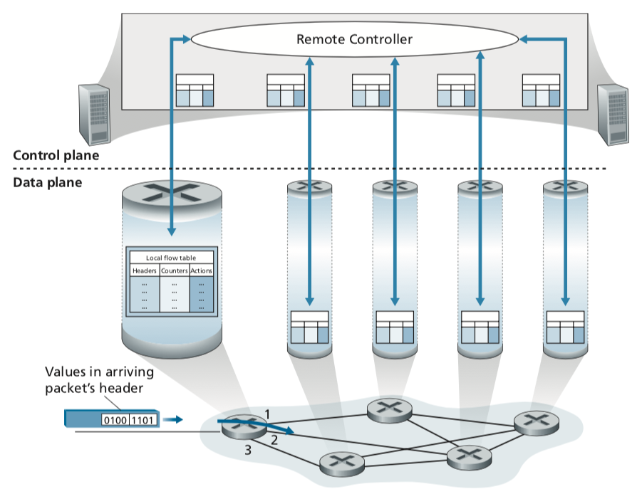
Generalized Forwarding and SDN
Overview
Generalized Forwarding:
Each packet switch contains a match-plus-action flow table that is computed and distributed by a remote controller.
Kurose, J.F. and Ross, K.W. (2021). Computer Networking: A Top-Down Approach (8th Edition). Pearson Education Limited, England. (pp. 353)
Notes:
Our following discussion of generalized forwarding will be based on Open- Flow [McKeown 2008, ONF 2020, Casado 2014, Tourrilhes 2014]—a highly visible standard that has pioneered the notion of the match-plus-action forwarding abstrac- tion and controllers, as well as the SDN revolution more generally [Feamster 2013]. We’ll primarily consider OpenFlow 1.0, which introduced key SDN abstractions and functionality in a particularly clear and concise manner. Later versions of OpenFlow introduced additional capabilities as a result of experience gained through
implementation and use; current and earlier versions of the OpenFlow standard can be found at [ONF 2020]

Slide 139
Generalized Forwarding and SDN
Overview
Generalized forwarding will be based on a standard rule → Open-Flow.
It is a highly visible standard that has pioneered the notion of the match-plus-action forwarding abstraction and controllers.
OpenFlow1.0 is used, which introduced key SDN abstractions and functionality
Kurose, J.F. and Ross, K.W. (2021). Computer Networking: A Top-Down Approach (8th Edition). Pearson Education Limited, England. (pp. 353)

Slide 140
Flow table abstraction
flow: defined by header field values (in link-, network-, transport-layer fields)
generalized forwarding: simple packet-handling rules
  match: pattern values in packet header fields
  actions: for matched packet: drop, forward, modify, matched packet or send matched packet to controller
  priority: disambiguate overlapping patterns
  counters: #bytes and #packets
Flow table
Router’s flow table define router’s match+action rules
match
action

Slide 141
Flow table abstraction
flow: defined by header fields
generalized forwarding: simple packet-handling rules
  match: pattern values in packet header fields
  actions: for matched packet: drop, forward, modify, matched packet or send matched packet to controller
  priority: disambiguate overlapping patterns
  counters: #bytes and #packets
Flow table
src = *.*.*.*, dest=3.4.*.* forward(2)
match
action
src=1.2.*.*, dest=*.*.*.* drop
src=10.1.2.3, dest=*.*.*.* send to controller
* : wildcard
1
4
3
2

Slide 142
OpenFlow: flow table entries
Match
Action
Stats
Packet + byte counters
Forward packet to port(s)
Drop packet
Modify fields in header(s)
Encapsulate and forward to controller
Header fields to match:
Ingress Port
Src MAC
Dst MAC
Eth Type
VLAN
ID
VLAN
Pri
IP Src
IP Dst
IP Proto
IP
ToS
TCP/UDP Src Port
TCP/UDP Dst Port
Link layer
Network layer
Transport layer

Slide 143
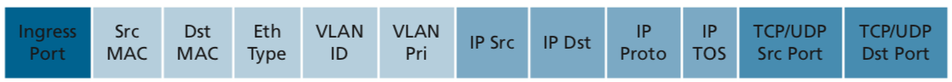
OpenFlow: Example
Examples 1
Destination-based forwarding:
Action
51.6.0.8
port6
* * * * * * * * * * *
IP datagrams destined to IP address 51.6.0.8 should be forwarded to router output port 6
Destination-based layer 2 (switch) forwarding:
Action
* * * * * * * * * * *
port3
22:A7:23:
11:E1:02
Layer 2 frames from MAC address 22:A7:23:11:E1:02 should be forwarded to output port 3

Slide 144
OpenFlow: Example
Examples 2
Firewall:
Action
22
Drop
* * * * * * * * * * *
Block (do not forward) all datagrams destined to TCP port 22
Action
128.119.1.1
Drop
* * * * * * * * * * *
Block (do not forward) all datagrams sent by host 128.119.1.1

Slide 145
OpenFlow: Abstraction
match+action: abstraction unifies different kinds of devices
Router
  match: longest destination IP prefix
  action: forward out a link
Switch
  match: destination MAC address
  action: forward or flood
Firewall
  match: IP addresses and TCP/UDP port numbers
  action: permit or deny
NAT
  match: IP address and port
  action: rewrite address and port

Slide 146


OpenFlow example
Examples 3
Host h6
10.3.0.6
Orchestrated tables can create network-wide behavior, e.g.,:
datagrams from hosts h5 and h6 should be sent to h3 or h4, via s1 and from there to s2
1
s3
controller
2
3
4
Host h5
10.3.0.5
1
s1
1
s2
Host h1
10.1.0.1
2
4
Host h4
10.2.0.4
4
2
3
3
Host h2
10.1.0.2
Host h3
10.2.0.3

Slide 147
OpenFlow: Example
Examples 3
Datagrams from hosts h5 and h6 should be sent to h3 or h4, via s1 and from there to s2
match
action
IP Src = 10.3.*.*
IP Dst = 10.2.*.*
forward(3)
Host h6
10.3.0.6
1
s3
controller
2
3
4
Host h5
10.3.0.5
1
s1
s2
1
2
Host h4
10.2.0.4
4
2
4
Host h1
10.1.0.1
3
3
Host h2
10.1.0.2
match
action
match
action
Host h3
10.2.0.3
ingress port = 2
IP Dst = 10.2.0.3
ingress port = 2
IP Dst = 10.2.0.4
forward(3)
ingress port = 1
IP Src = 10.3.*.*
IP Dst = 10.2.*.*
forward(4)
forward(4)

